Slide 1
Laravel Framework
…

Slide 2
Laravel
Open source framework
Based on model-view-controller (MVC) design pattern
Laravel can save developers thousands of lines of code that raw PHP
CodeIgniter, Symfony, Laravel, and Yii are some of the popular PHP frameworks available in market.
Laravel uses all the good features from all the other frameworks, which makes it great.

Slide 3
Features of Laravel/1
database access tools
Query builder, Object Relational Mapper (ORM) and active record called Eloquent, database migration, database migration.
2. Command line tool called artisan – you can do almost everything from here.
3. Routing – done only in one page (only one location) – API like
4. View template engine – no inline PHP anymore.
5. Job scheduling job – Now it is easy to schedule events e.g. sending emails, clearing unnecessary data from database, creating and sending reports

Slide 4
Features of Laravel/2
6. Subscription and billing – Laravel introduced cashier; handling coupons, pdf invoicing etc… made painless.
7. Authentication/socialite - Laravel eases designing authentication as it includes features such as register, forgot password and send password reminders and socialite – OAuth providers – Google, Facebook, twitter etc.
8. Email – A class that can send rich content emails.
9. Queue – for transacting long operations such as sending thousands of marketing emails and SMS.

Slide 5
What is composer?
A tool for dependency management.
It allows you to declare the libraries your project depends on and it will manage (install/update) them for you.
We use composer.json, a plain json file that is placed under the project root directory, which defines the metadata for all project package dependencies.

Slide 6
Laravel installation
…

Slide 7
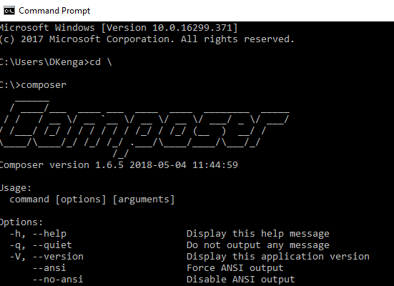
Laravel installation/1
Laravel uses composer, so we have to install composer first
Visit the following URL and download composer to install it on your system (https://laravel.com/docs/5.8#installation ).
After the Composer is installed, check the installation by typing the Composer command in the command prompt as shown in the following screenshot.

Slide 8


Laravel installation/2
3. Create a new directory anywhere in your system for your new Laravel project. After that, move to path where you have created the new directory and type the following command there to install Laravel.
4. The above command will install Laravel in the current directory. Start the Laravel service by executing the following command.
5.

Slide 9

Laravel installation/3
6. Copy the URL underlined in gray in the above screenshot and open that URL in the browser. If you see the following screen, it implies Laravel has been installed successfully.

Slide 10
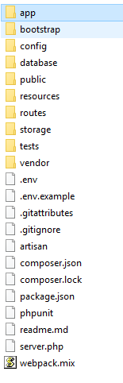
Laravel application structure
See folder structure below

Slide 11
app folder
App: This directory is the meat of the application and contains the core code.Console: This directory contains all the custom Artisan commands created using make:command
Exceptions: This directory contains the application’s exception handler and is a good place to add custom exception classes to handle different exceptions thrown by your application
Http: This directory contains all your controllers, middleware and requests
Providers: This directory contains all your service providers for the application. You can know more about service providers here

Slide 12
Other folder
Bootstrap: This directory contains framework bootstrap as well as configuration files. It also contains Cache directory which contains framework generated cache files
Config: This directory contains all your application’s configuration files.
Database: This directory contains all database migrations and seeds. You can also store SQLite database file here
Public: This directory contains assets like images, js files and CSS.
Routes: This directory contains all routes definitions for the application. php is the file which receives all the requests to your application and here you can redirect the requests to their respective controller methods.
Storage: This directory contains blade templates, session files, cache files and other.
Tests: This directory contains all the test files
Vendor: This directory contains all composer dependencies

Slide 13
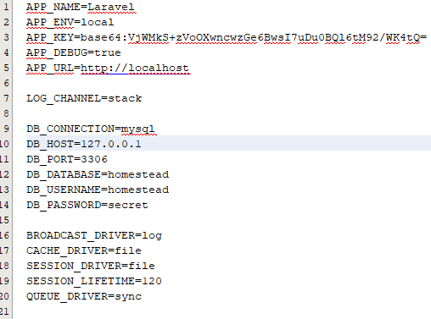
The .env file
For backup options, the development team should include the .env.example file, which should contain the default configuration

Slide 14


Routing
Laravel requests are mapped with the help of routes
All the application routes are registered within the routes/ folder files. This file tells Laravel for the URIs it should respond to and the associated controller will give it a particular call.
I can change the route as follows

Slide 15
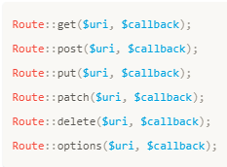
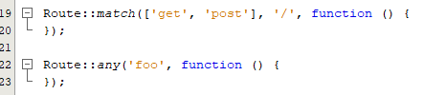
Routing
register a route that responds to multiple HTTP verbs
Available router methods

Slide 16
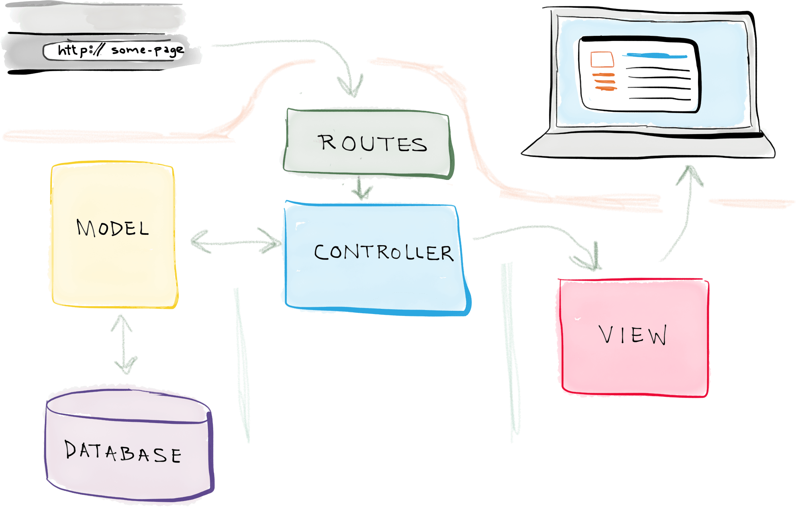
Model-View-Controller

Slide 17
The simple request process
A request is made — say, when a user enters a URL associated with your application e.g. http://strathmore.edu/users
A route associated with that URL maps the URL to a controller action. So Controllers have methods called actions ☺
That controller action leverages the necessary model(s) to retrieve information from the database, and then passes that data off to a view – You see how a controller connect view and model.
And that view renders the final page – now your user can see this.

Slide 18
Steps to create your first Laravel Application
Create your project:
composer create-project laravel/laravel --prefer-dist app
2. Create a database in a DBMS of your choice
e.g. execute create database app;
3. Configure database and create a database in your server
At development - .env file
At production – config/database
Laravel by default supports 4 databases: MySQL (Postgres,SQLite,SQL,Server)
3. Start off: you can start with Make Auth:
php artisan make:auth
4. Execute php artisan migrate from your terminal
You might see an error like 1071 Specified key was too long; max key length is 767 bytes. If you do add this code in app/Providers/AppServiceProvider.php)

Slide 19
Steps to create your first Laravel Application
In the boot method of AppServiceProvider.php, add this line
Schema::defaultStringLength(191);
And import the following class in the same file:
use Illuminate\Support\Facades\Schema;
Now visit http://localhost:8000/home
You’ve created a simple authentication application.
Notes:
Lets use this tutorial here
https://selftaughtcoders.com/from-idea-to-launch/lesson-17/laravel-5-mvc-application-in-10-minutes/
https://vegibit.com/how-to-use-the-laravel-query-builder/

Slide 20
Creating Models
Assuming we want to create a simple application about cars
Use the artisan CLI
php artisan make:model Car --migration
A model is created in app, so we will have app/Car
By default, Laravel assumes that the Car model is created.
And, actually, by supplying that --migration option when generating the model, Laravel also generates a database migration file for creating that cars database table.
The migration file is located at [timestamp]_create_cars_table.php in app/database/migrations

Slide 21
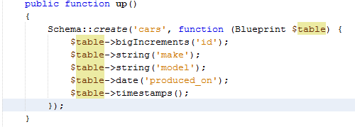
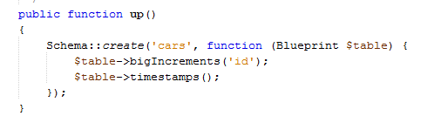
Creating Models
Add more fields for your table like in
Running php artisan migrate will create a cars table in your DBMS
Read more on table columns and types here: https://laravel.com/docs/5.8/migrations#creating-columns

Slide 22
Creating Controllers
We can create a controller to handle all requests associated with a model:
php artisan make:controller CarController
Controllers are in app/Http/Controllers folder
A controller will have all the action methods, which handle any request e.g. requesting from a browser using a URL.

Slide 23

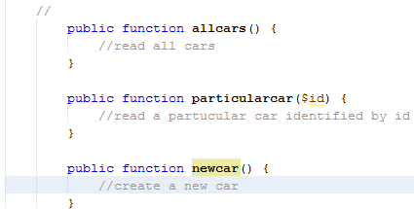
Routes
Routes shows, which actions methods are associated with which request.
We can create routes as this in web.php
Then their associated action methods in CarController.php as

Slide 24
Creating views
Laravel view files are all stored in the resources/views folder.
And they can be organized into subfolders within that directory.
In Laravel views are names as name.blade.php, where ‘name’ is the name of the view.
If you name a view file as allcars.blade.php, then you will refer it to as allcars, but if the view file in a folder called cars, the you refer to it as cars.allcars.
Laravel uses the blade templating engine hence the ___.blade.php naming convention.

Slide 25
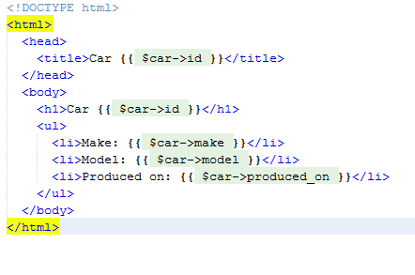
Creating views
For our cars application, the allcars.blade.php view would be something like this:
This is an ordinary html document with {{..}} for inserting dynamic data (same as echo in php). This is how the blade templating engine works.
Start with an @, when introducing a control structure such as if…else as
@if (condition)
……….
@elseif (condition)
……
@else
…..
@endif

Slide 26
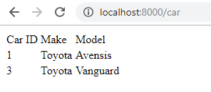

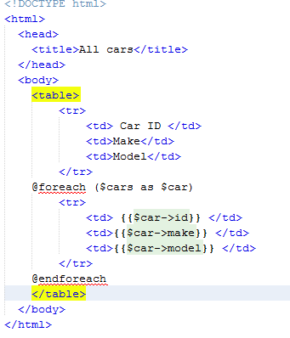

Using eloquent to retrieve models
From our Cars model, we can retrieve model data by using
$cars = Car::all(), in summary we have this,

Slide 27
More on Eloquent
Getting all records: Car::all()
Behind the scene, the query eloquent executes is
Select * from cars;
Finding a specific record by its id: Car::find($id)
Inserting a new record with:
$car = new Car;
$car->make= “Toyota”;
$car->model= “vanguard”;
$car->produced_on= “2019-04-18”;
$car->save()

Slide 28
More on Eloquent
Get a record(s) using where clause: Car::where('id', '>', 3)->get();
This is equivalent to: select * from cars where id > ‘3’;
Using where and like: Game::Cars(‘model', 'like', '%es%')->get();
Equivalent to: select * from cars where model like ‘%es%’;
Using orderBy: Car::orderBy(model', 'desc')->get();
Limiting The Number of Results using take(): Car::orderBy(model', 'desc')->take(3)->get();
Use of pluck() to specify field of interest: Car::pluck(model');
Equivalent to: select model from cars;
Note that quarries do not run until you call get()

Slide 29
More on Eloquent
Updating a model:
$car = Car::find($id); id
$car->make = “Toyo”;
$car->save();
Deleting a mode:
$car = Car::find($id);
$car->delete();
There is more that eloquent can do! Visit Laravel site and learn more.

Slide 30
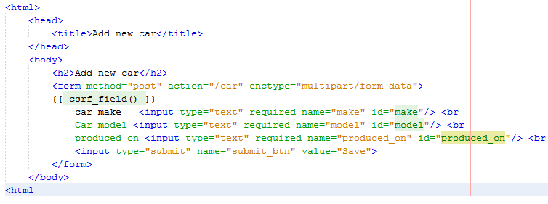
Form submission in Laravel
We can create a form in Laravel to save our car records such as:
Create a route to display the form <!--- {{url(/car)}}-->
Route::get('/car/new','CarController@newcarform');
csrf_field is required to protect against cross site request forgery, you must include this field just after the opening form tag like you see above.
If this is not included, you will run into token mismatch errors.

Slide 31
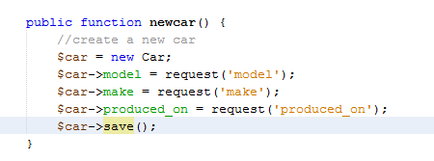
Form submission in Laravel
Add a post route to receive the form as: Route::post('/car','CarController@newcar'); so the action method is newcar.
In the action method, receive the form as:
Notice the request() helper function to access the data we want from the form.

Slide 32
Form submission in Laravel
For an image, it could have been something like this:
$car->image = request()->file(‘image’)->store(‘public/images’);
Two things you have to notice here:
Laravel is accepting the file from our form submission, and storing it in the application at storage /app/public/images
The path for the image is stored in $car->image so we fetch the image source when we want to display it to the browser later on
To display an image on the browser using Laravel, do it this way:
<img src="{{ Storage::url($car->image) }}" alt="Car image ">; where $car is the car object, which represents a row in your table.

Slide 33
Form submission in Laravel
To show messages to the user after form submission, you may want to use Laravel sessions with flash method as:
public function newcar(Request $request){}
$request->session()->flash(‘form_status', ‘Form submission was successful!');
The in the form view loop as:
@if (Session::has(form_status '))
session(form_status ')
@endif

Slide 34
Form submission in Laravel - Validation
Validation can be accomplished using JavaScript or html5.
However, this may not sufficient, thus calling for server side validation.
We add a validation rule in our newcar() method as shown just before receiving the form data:
$this->validate(request(), [
’make' => 'required',
’model' => 'required|unique:cars ',
’produced_on' => 'required',
'image' => 'required',
]);
There are several validation rules but illustrate using ‘required’ and title is unique…

Slide 35
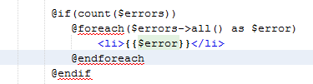
Form submission in Laravel - Validation
Errors encountered from form validation can be displayed as well.
If there was a problem, an $errors variable will be populated and the user is re-directed back to the form from which they came and can be looped through as:

Slide 36
Form submission in Laravel - Validation
Filling big forms can be frustrating when making errors and loosing data during validation.
We can make good use of Laravel’s old() function as:
car make <input type="text" name="make" id="make" value="{{ old('make') }}"> > we add a value tag whose value comes from old() function.

Slide 37

Eloquent relationships
If wanted to add reviews to our cars, then reviews table and cars table have to have relationships.
This relationship is stored within Laravel, thus this relationships exist between Models.
One car has many reviews thus there is a OneToMany relationship.
Thus in the car model, add a method as below:
Notice the method reviews is plural.
Now reviews belongs to car

Slide 38


Eloquent relationships
In the Review model, we add a function like the one below in the Review Model:
With this relationship, one can get reviews from a car object and a car from a review object belongs.
Example: To get reviews for car with id=1 can be done as:
Similarly with car from review.

Slide 39
RESTful APIs in Laravel
API design was thought about carefully when Laravel was being build.
We have already discussed about how to design APIs previously.
The only difference between web applications routes and end points API is that in APIs, routes are placed in routes/api.php
Thus, if we have a recourse called car with some id 1, which needs to be retrieved, then we may proceed as follows:
Create a controller Mycontroller with some method called search($id)
Add a route in routes/api.php file such as Route::get(‘car/{id}’,’ Mycontroller @ search’)
Hit the endpoint like /api/car/1 plus any other data that may be required such as API key.
You can return data in any format such as JSON from a Laravel action method

